Slide 1
Regional Sales Summary Project
Marian Pattugalan

Slide 2
Problem Statement
“Sales teams often lack a clear, data-driven understanding of regional performance, making it difficult to identify growth opportunities and optimize resources. This project aims to analyse and visualize regional sales data to uncover trends, evaluate profitability, and support strategic decision-making.”

Slide 3
Approach 1
PHASE 1: Understanding the Data and Defining the Objectives
Gather context: What do each column in each sheet represent? How do the sheets relate to one another?
Define the objectives (what questions am I trying to answer?)
Look into the distribution of revenue across the different states in USA
Identify which Products sell the most, which Channel is the most profitable, etc.
Identify the peaks and troughs of sales throughout the year
PHASE 2: Set Up
Load the required libraries (Numpy, Pandas, Matplotlib, Seaborn)
Import the excel file and upload each sheet as a separate dataframe
Identify the relationships between each table and merge the data into one big df (‘merged_df’)
Get an overview of the data structures, using .head(), .tail(), .info(), .describe(), and .shape, to identify how the data needs to be cleaned.

Slide 4
Approach 2
PHASE 3: Data Cleaning
Checked data types, ensuring that each field was correctly assigned text, numeric, or date
Checked data quality, double-checking for any null values, errors, duplicates, whitespaces, irrelevant columns.
Make everything lowercase for easier recall
Feature Engineering: split date (mm/dd/yyyy) into two groups of columns: ‘Order Month Name’ and ‘Year’ for clearer analysis; created bins for median income
PHASE 4: Exploratory Data Analysis
Used EDA to uncover patterns, trends, and relationships through univariate and bivariate analyses.

Slide 5
Data Overview
Product Data
Index
Product Name
SALES Order
OrderNumber
OrderDate
Customer Name Index
Channel
Currency Code
Warehouse Code
Delivery Region Index
Product Description Index
Order Quantity
Unit Price
Line Total
Total Unit Cost
Gross Profit
Customers
Customer Index
Customer Names
Budget Data
Product Name
2017 Budgets
Regions
id
name
county
state_code
state
type
latitude
longitude
area_code
population
households
median_income
land_area
water_area
time_zone
State Regions
State Code
State
Region

Slide 6
Project Workflow
1.
2.
3.
Understand business problems and objectives
Acquire and import relevant dataset
Understand the schema of the data set
6.
5.
4.
Extract key insights and trends for each visualisation
Perform Exploratory Data Analysis
Merge dataframes together and clean data
7.
Present findings on presentation deck

Slide 7
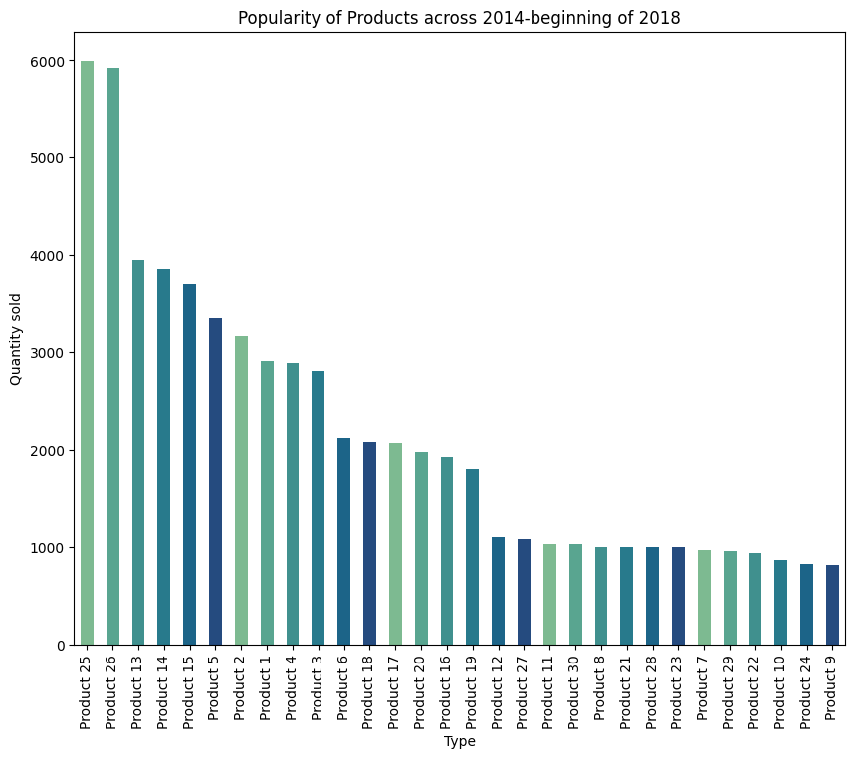
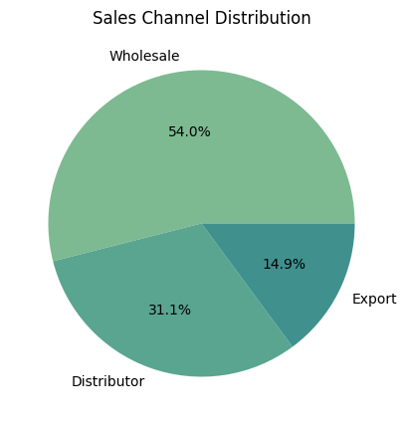
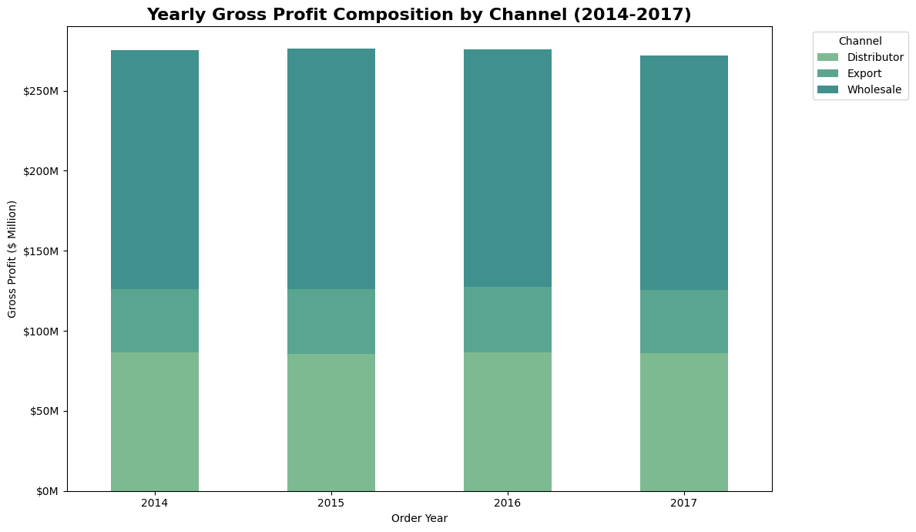
Exploratory Data Analysis (EDA)
Wholesale is the dominant channel for sales, making up majority of the gross profit.
Exports is the smallest channel contributor.
Most sold products: Product 25, Product 26, Product 13, Product 14, Product 15.
The graph is heavily skewed to the right, with most sales occurring with the top 5 products.

Slide 8
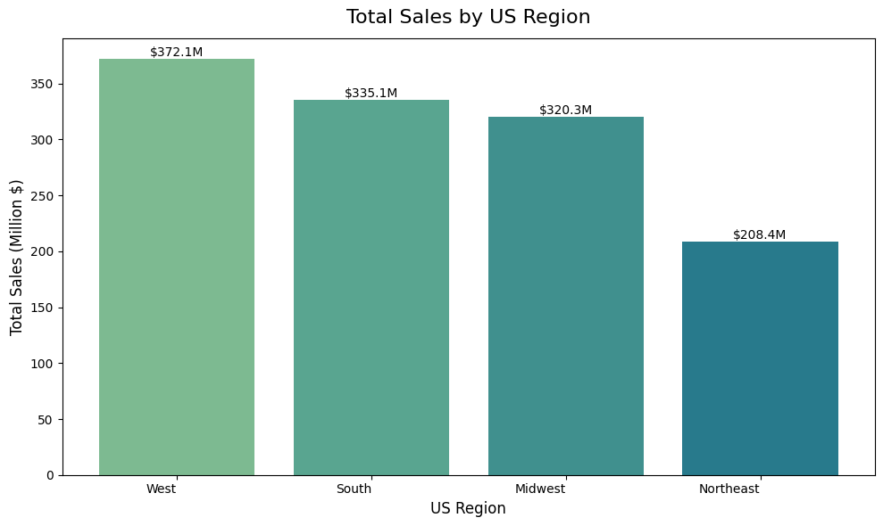
Exploratory Data Analysis (EDA)
The West is the most dominant region, having the highest total sales ($372M) and accounting for roughly 35% of the total sales.
The South and Midwest both show robust sales but are lower than the West.
The Northeast has the lowest amount of sales, approximately ~40% less than the West.

Slide 9
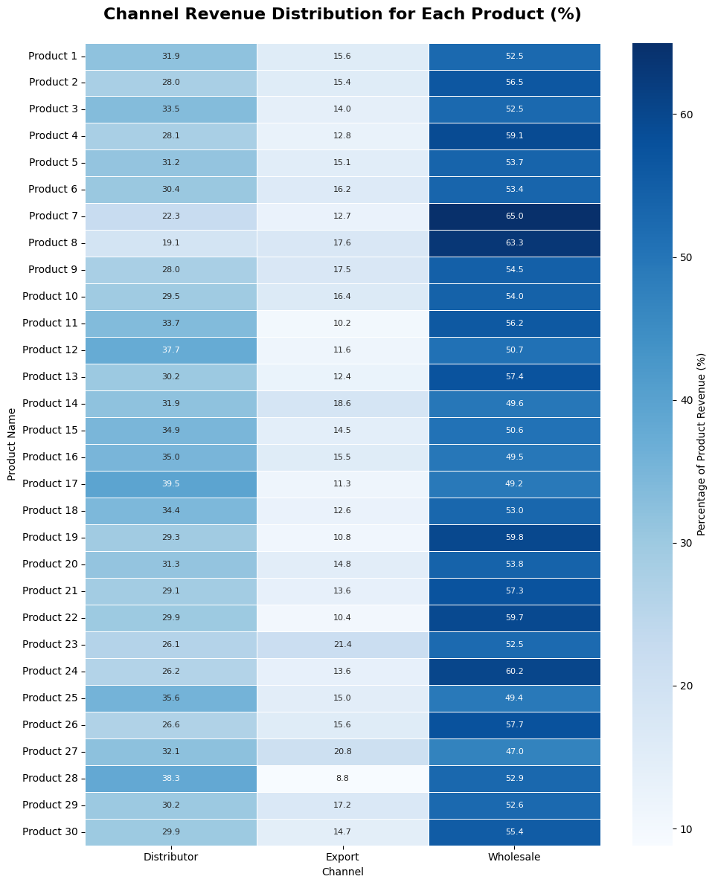
Exploratory Data Analysis (EDA)
Bivariate Analysis
Wholesale is the primary/dominant channel for every product sold (ranging from ~47-65%), generating the highest revenue percentage for all products.
Distributor is the second significant channel for all products (ranging from ~19-39%), with Product 12 (37.7%), Product 17 (39.5%), Product 25 (35.6%), and Product 28 (38.3%) showing higher reliance on this channel.
Export channel is the smallest contributor for all of the products (ranging from ~8-21%), with Product 23 (21.4%) and Product 27 (20.8%) deriving a significantly larger share of their revenue from exports compared to others like Product 28 (8.8%).

Slide 10
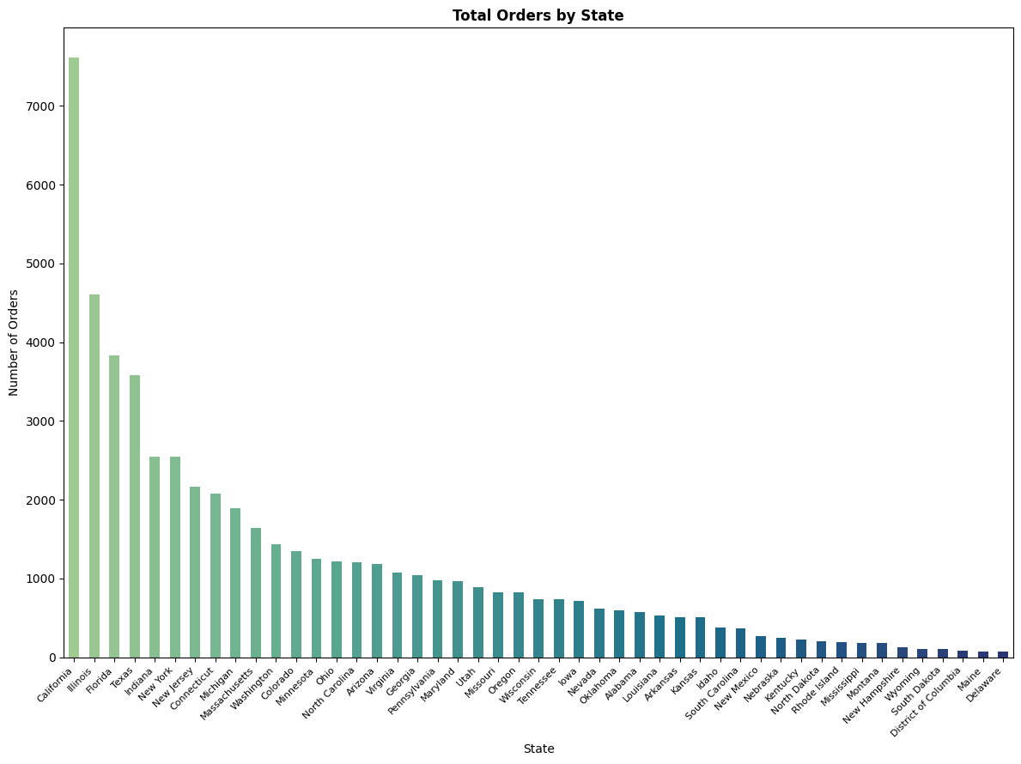
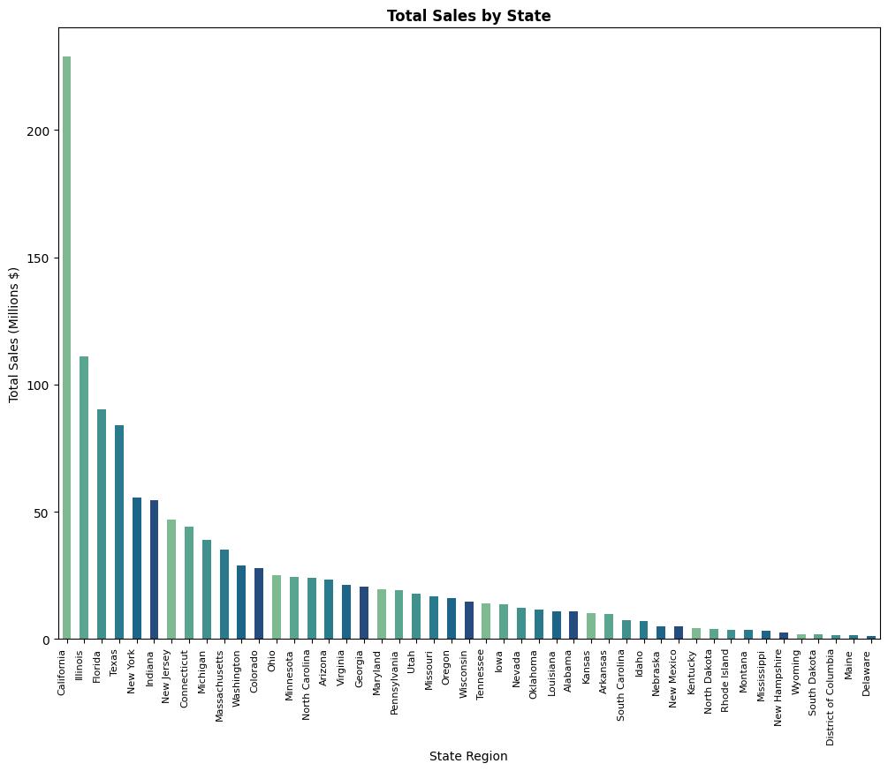
Exploratory Data Analysis (EDA)
California is the top-performing state, with the highest total revenue, exceeding $200M.
Illinois shows robust revenue but is significantly lower than California
Delaware, District of Columbia, Maine’s sales <= $10M, indicating low sales activity in these areas.
Sales follow the same trend

Slide 11
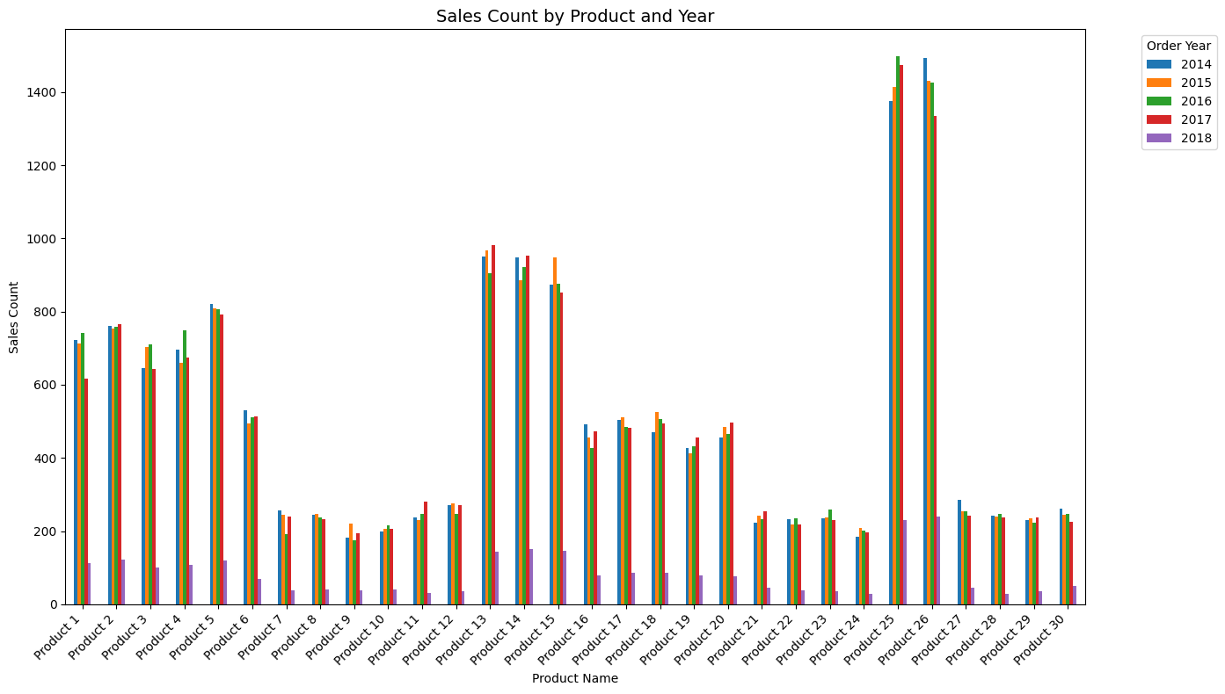
Exploratory Data Analysis (EDA)
Top 5 performing products from 2014-2017 (Product 25, Product 26, Product 13, Product 14, Product 15) account for ~36% (23,424) of total sales.
Lowest performing products (Product 9, Product 10, Product 22, Product 24, Product 29) sold less than 300 units per year.
Product 26 shows a significant decline (10%) in sales from 1,494 to 1,336 units) between 2014-2017
Product 11 shows the highest growth (17%) between 2014-2017.
Uneven distribution, with a small number of products making a large percentage of the sales volume.

Slide 12
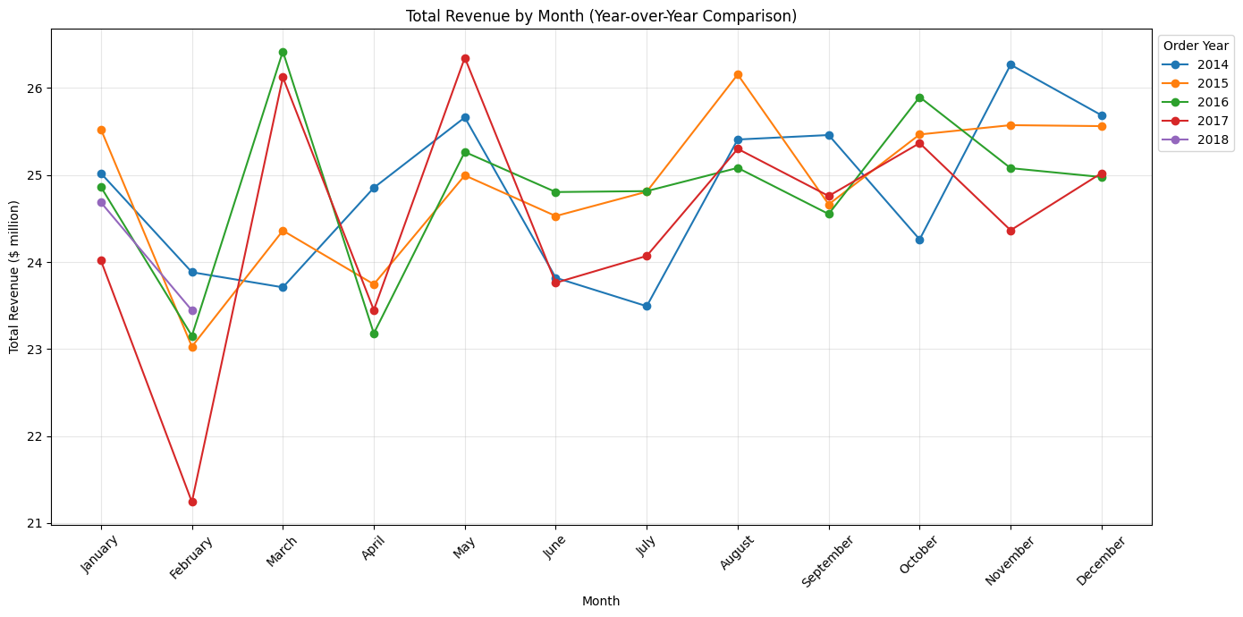
Exploratory Data Analysis (EDA)
The business is highly seasonal, showing trends with the peaks and troughs throughout the year.
Sales stay consistent between $24-26M throughout the months per year, but there is a dramatic drop in Feb(2017) which is an outlier.
There is a plateaus in revenue between October-December, making Q4 the highest revenue quarter in sales in every year.
Consistent decline in January-February indicates a post-holiday trough into the new year.
There are spike increases in April and May.
There is an upward trajectory per year post 2014, indicating a strong year-on-year growth.
There is no clear upward or downward trend, showing a stable seasonal pattern.

Slide 13
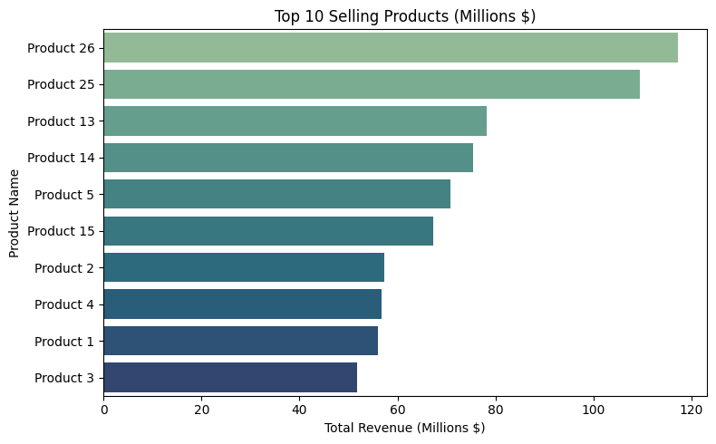
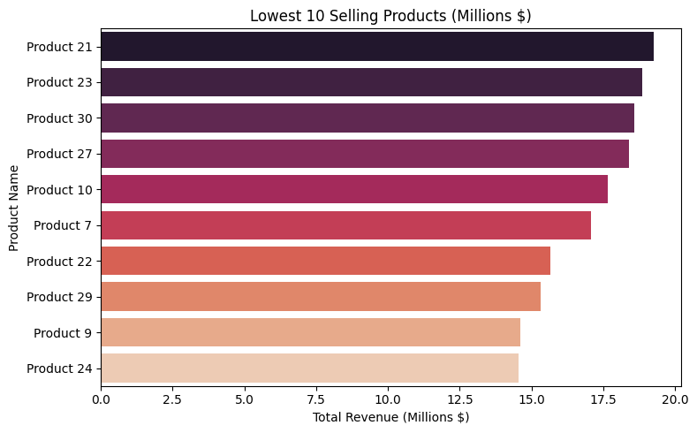
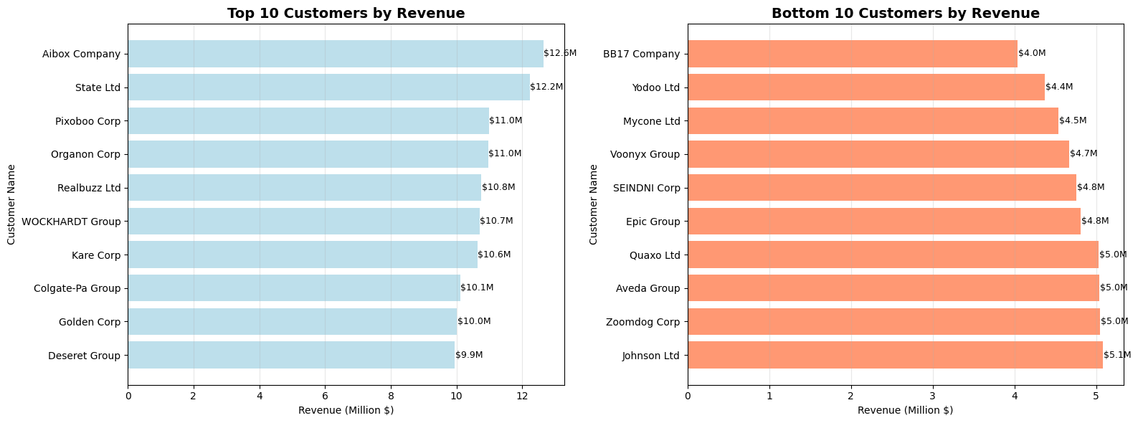
Exploratory Data Analysis (EDA)
Product 26 and 25 are the leading products in revenue (with revenues more than $100M).
Product 24 is the lowest selling product, with a revenue just under $15M.
Aibox Company is the highest revenue customer ($12.6M), closely followed by State Ltd ($12.2M).
There is a steep 12.7% decrease between Aibox Company and the third highest revenue company.
The top 10 bottom customers by revenue are below $5M, which is around 60% lower than the highest revenue companies.
This shows that majority of the revenue are from the top customers.

Slide 14
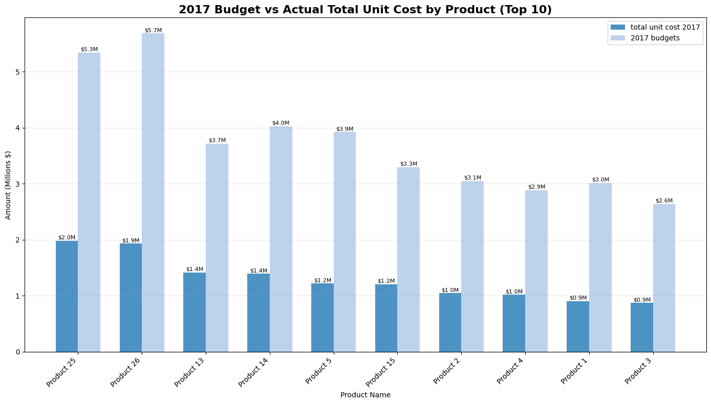
Exploratory Data Analysis (EDA)
Bivariate Analysis on 2017
For every product, the allocated budget significantly exceeds the actual total unit cost. Shows consistent budget overestimation in terms of raw material prices or labour.
The cost only account for around ~35% (range: 30.8-37.8%).
Product 25 and Product 26 have the biggest variances ($3.3M and $3.8M, probably indicating ambitious planning for sales.
Lower actual costs could mean higher gross profits.

Slide 15
Key Insights
Monthly revenue is consistent throughout the years, with consistent spikes in May and April and a strong Q4(Oct-Dec). A dip in revenue can be seen in January-February, indicating a post-holiday trough.
The Western region (particularly California with $230M revenue and around 7500 orders) dominates in sales performance. Meanwhile, the Northeastern region (e.g. Delaware with than $5M and less than 1000 orders) has the weakest regional performance.
Distribution of channels relies largely on wholesale: Wholesale (54%), Distributors (31%) and Exports (15%)
Product 26 and Product 25 have the highest revenues and sales
Product 24 and Product 9 have the lowest revenues and sales
There is gross miscalculation on the budget of each Product.
Based on patterns, expect 2018 to follow similar seasonality (unless disrupted by external factors). Avg annual revenue/year is around $290-300M.

Slide 16
Recommendations
Northeast region’s lower sales indicate that there is a big opportunity for growth here via targeted marketing, improved channel distribution, and tailored promotions.
Provide additional product promotions, deals, or rebranding for the underperforming products
Prioritize relationship management with top companies to sustain high revenue contribution, but also explore upselling opportunities with lower-tier customers to boost their revenue.
Recurring February dip could inform that more marketing should be conducted in Q1
Conduct additional promotions for Product 26 as its revenue dropped significantly in 2017.
Utilise the growth of Product 11 to further increase its revenue for 2018.
Recalibrate the budgets for each Product and allocate more budget for advertisements/promotion into Products which are underperforming
Notes:
Inconsistent revenue and profit performances across US regions
Lack of visibility into seasonal swings, top SKUs, and channel profitability
Leverage 5 years of historical data to pinpoint growth levers and optimise strategy

